Slide 1
Linear regression
Session 20
Henry Lucky, S.Kom., M.Kom.

Slide 2
Learning Outcomes
Session 20
At the end of this session, students will be able to:
LO 5: Apply various learning algorithms for agents to solve problems

Slide 3
outline
Session 20
Simple Linear Regression
Multi variable Regression: Bivariate
Multi variable Linear Regression

Slide 4
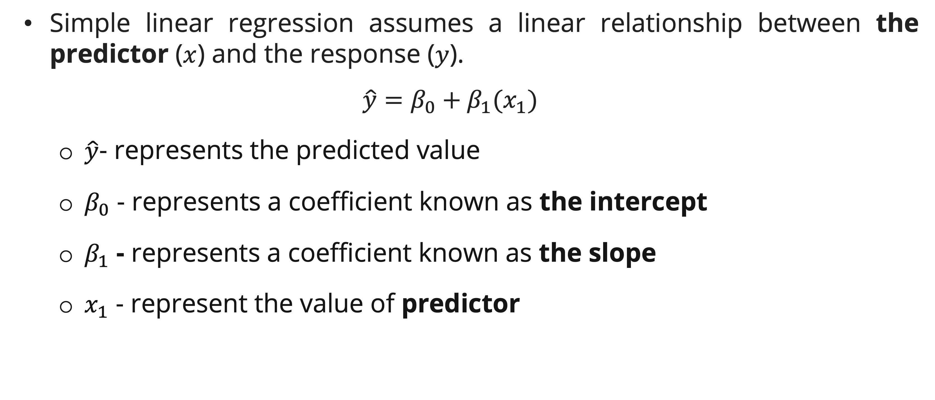
Simple linear regression
Definition
  Simple linear regression assumes a linear relationship between the predictor ($x$) and the response ($y$).
  $$\hat{y}=β_{0}+β_{1}(x_{1})$$
    $\hat{y}$- represents the predicted value
    $β_{0}$ - represents a coefficient known as the intercept
    $β_{1}$ - represents a coefficient known as the slope
    $x_{1}$ - represent the value of predictor

Slide 5
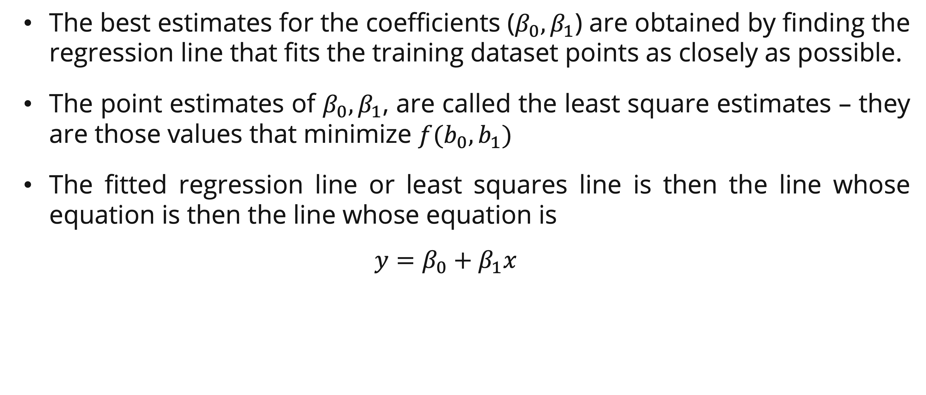
Simple linear regression
Least square criteria
  The best estimates for the coefficients ($β_{0}, β_{1}$) are obtained by finding the regression line that fits the training dataset points as closely as possible.
  The point estimates of $β_{0}, β_{1}$, are called the least square estimates – they are those values that minimize $f(b_{0},b_{1})$
  The fitted regression line or least squares line is then the line whose equation is then the line whose equation is
  $$y=β_{0}+β_{1}x$$

Slide 6
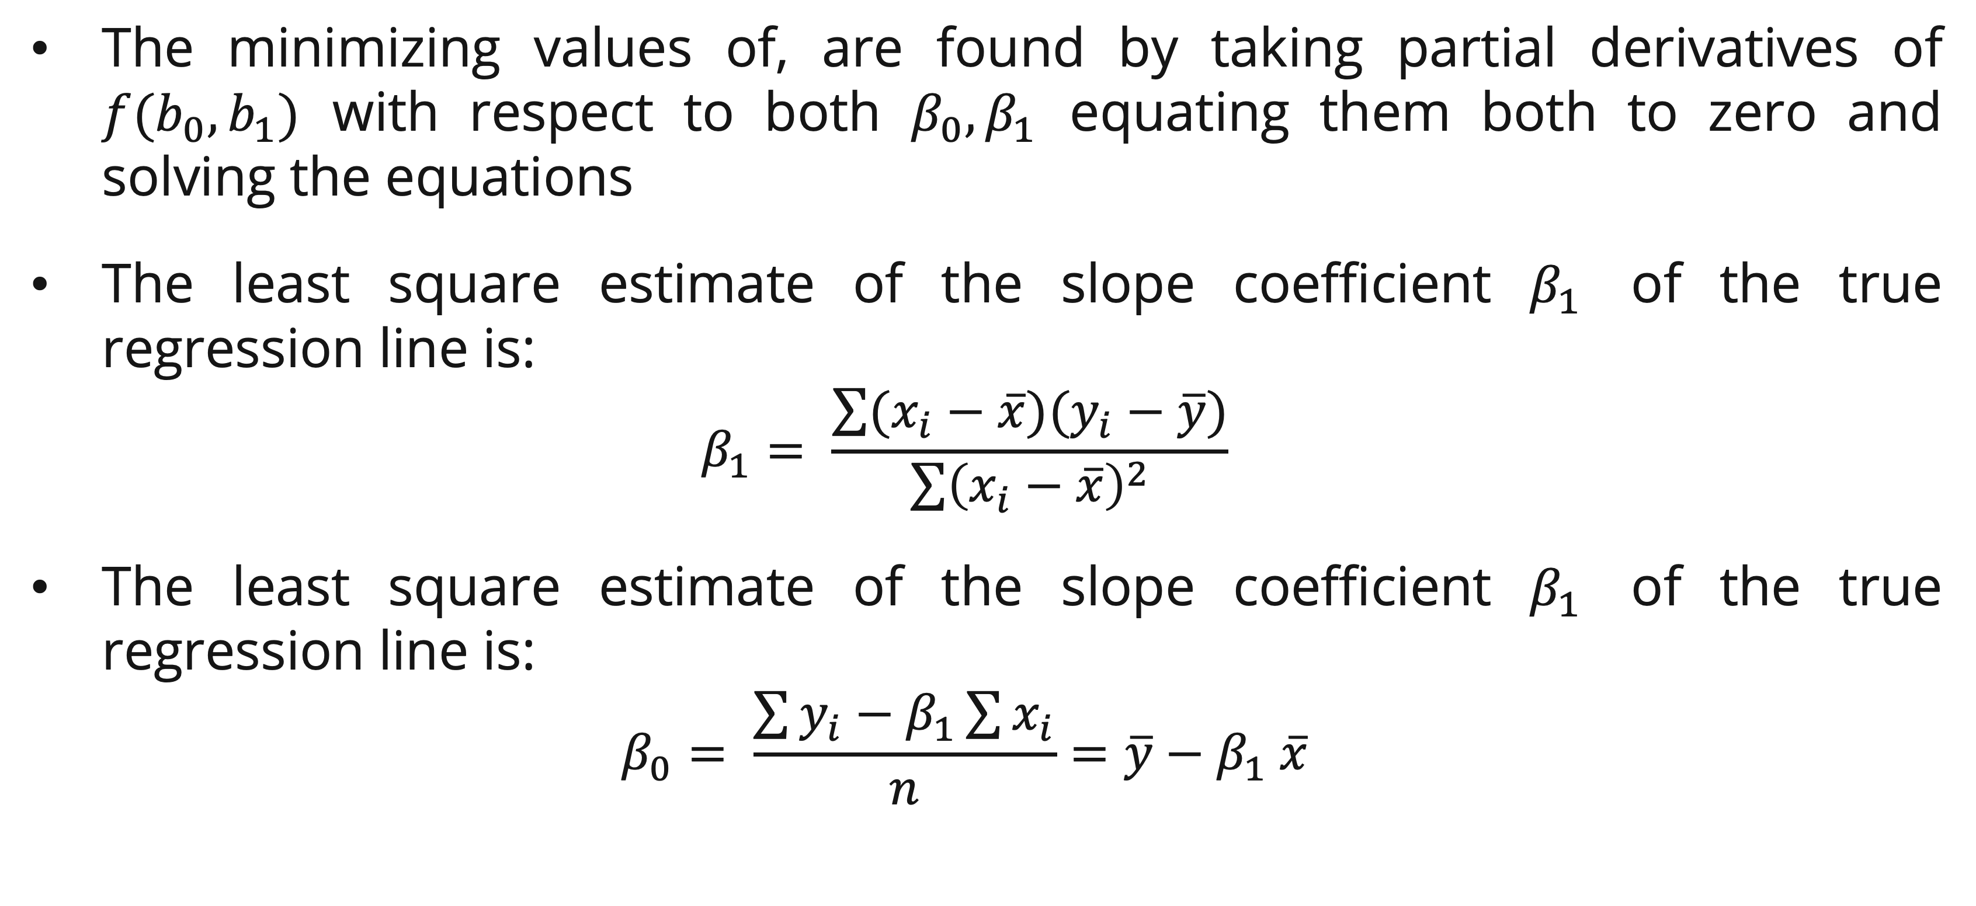
Simple linear regression
Least square criteria
The minimizing values of, are found by taking partial derivatives of $f(b_{0},b_{1})$ with respect to both $β_{0}, β_{1}$ equating them both to zero and solving the equations
The least square estimate of the slope coefficient $β_{1}$ of the true regression line is:
  $$β_{1}= \frac{\sum{(x_{i}−\overline{x})(y_{i}−\overline{y})}}{\sum{{\left(x_{i}−\overline{x}\right)}^{2}}}$$
The least square estimate of the slope coefficient $β_{1}$ of the true regression line is:
  $$β_{0}= \frac{\sum{y_{i}}−β_{1}\sum{x_{i}}}{n}=\overline{y}−β_{1} \overline{x}$$

Slide 7
Simple linear regression
Example
The Tasty Sub Shop is a restaurant chain that sells franchises to business entrepreneurs. Franchise regulations allow Tasty Sub (and other chains) to help entrepreneurs understand the factors that affect restaurant profitability and to provide basic guidance in evaluating potential restaurant sites. However, in order to prevent restaurant chains from overpredicting profits and thus misleading potential franchise owners, these regulations make each individual entrepreneur responsible for predicting the profits of his or her potential restaurant sites.
Find the fitted regression​

Slide 8
Simple linear regression
Example

Slide 9
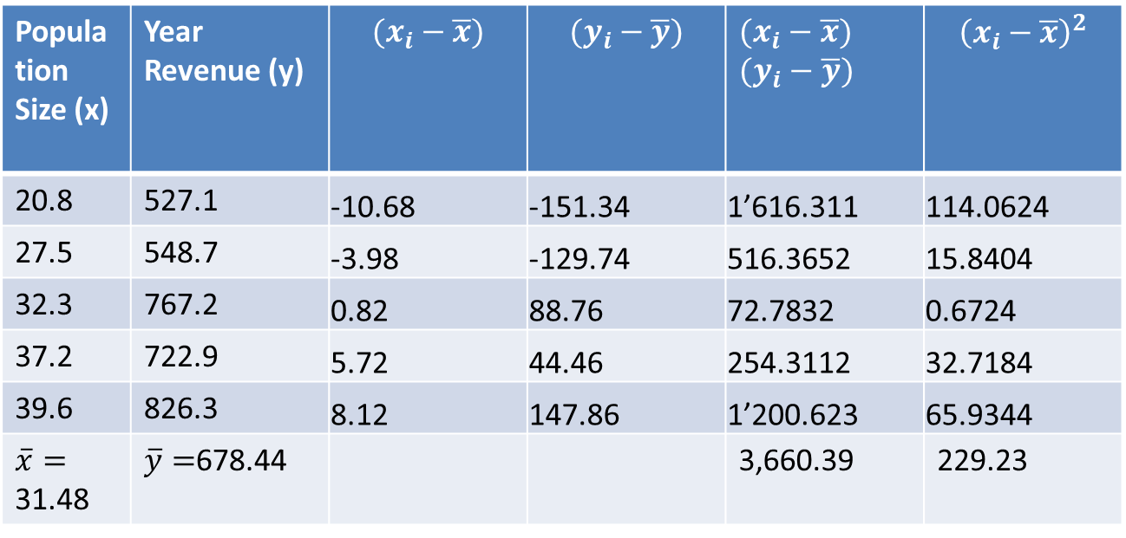
Simple linear regression
Example

Slide 10
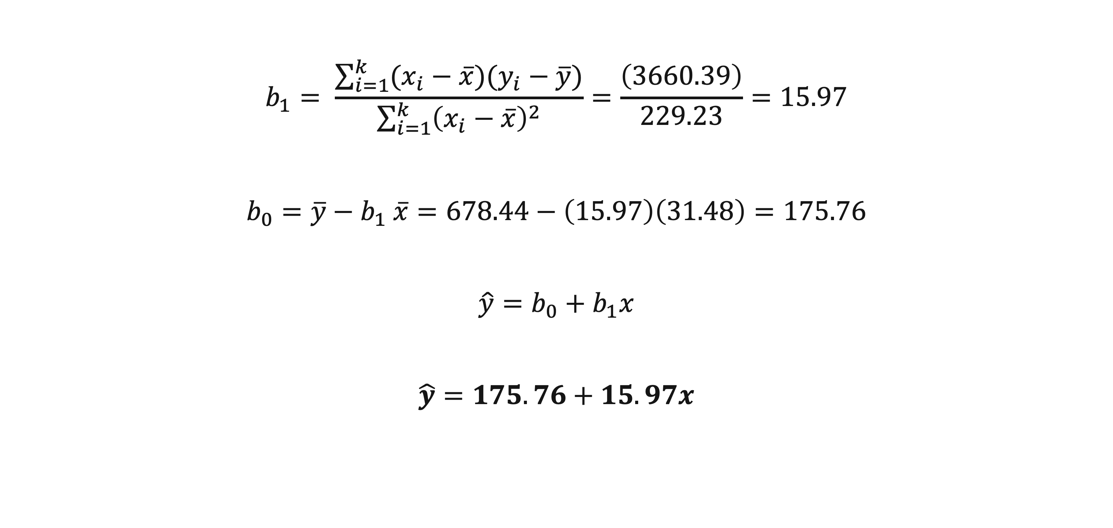
Simple linear regression
Example
$$b_{1}= \frac{\sum_{i=1}^{k}{(x_{i}−\overline{x})(y_{i}−\overline{y})}}{\sum_{i=1}^{k}{{\left(x_{i}−\overline{x}\right)}^{2}}}=\frac{\left(3660.39\right)}{229.23}=15.97$$
$$b_{0}=\overline{y}−b_{1} \overline{x}=678.44−\left(15.97\right)\left(31.48\right)=175.76$$
$$\hat{y}=b_{0}+b_{1}x$$
$$\hat{y}=175.76+15.97x$$

Slide 11
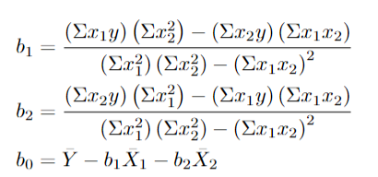
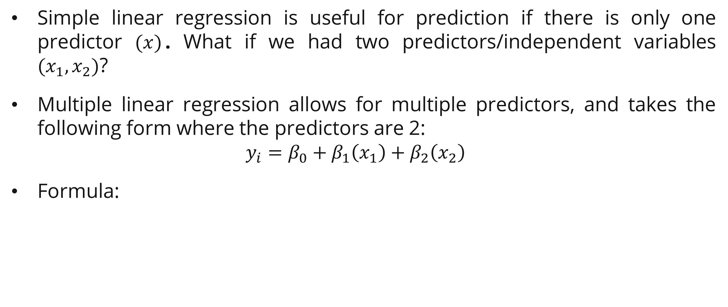
Multi variable regression: 2 Predictors
Example
Simple linear regression is useful for prediction if there is only one predictor $(x)$. What if we had two predictors/independent variables $(x_{1},x_{2})$?
Multiple linear regression allows for multiple predictors, and takes the following form where the predictors are 2:
  $$y_{i}=β_{0}+β_{1}\left(x_{1}\right)+β_{2}\left(x_{2}\right)$$
Formula:

Slide 12
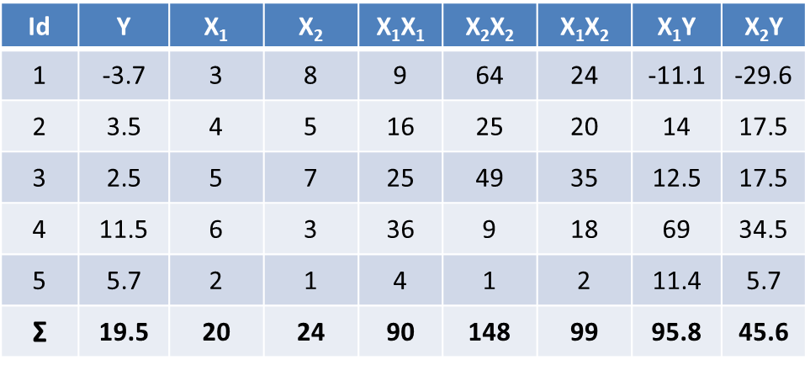
Multi variable regression: 2 Predictors
Example

Slide 13
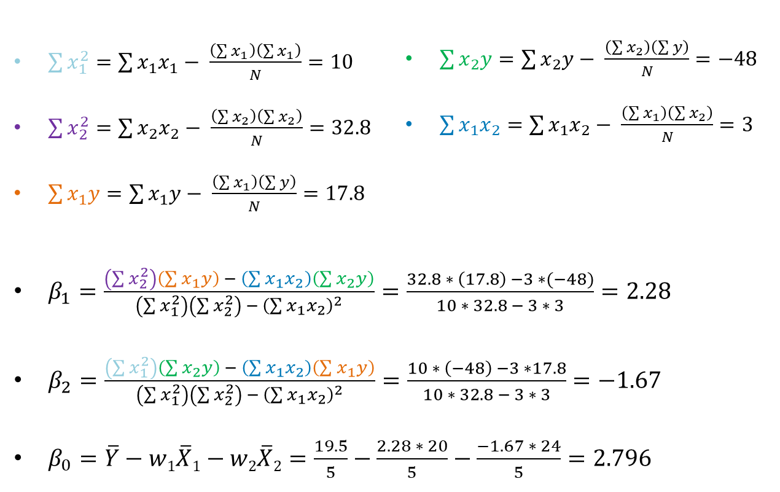
Multi variable regression: 2 Predictors
Example

Slide 14
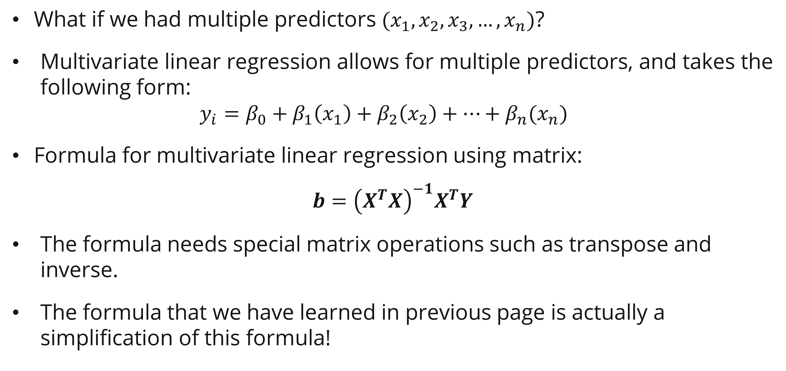
Multi variable regression
Definition and formula
What if we had multiple predictors $(x_{1},x_{2}, x_{3}, …, x_{n})$?
Multivariate linear regression allows for multiple predictors, and takes the following form:
  $$y_{i}=β_{0}+β_{1}\left(x_{1}\right)+β_{2}\left(x_{2}\right)+…+β_{n}(x_{n})$$
Formula for multivariate linear regression using matrix:
$$b={\left(X^{T}X\right)}^{−1}X^{T}Y$$
The formula needs special matrix operations such as transpose and inverse.
The formula that we have learned in previous page is actually a simplification of this formula!

Slide 15
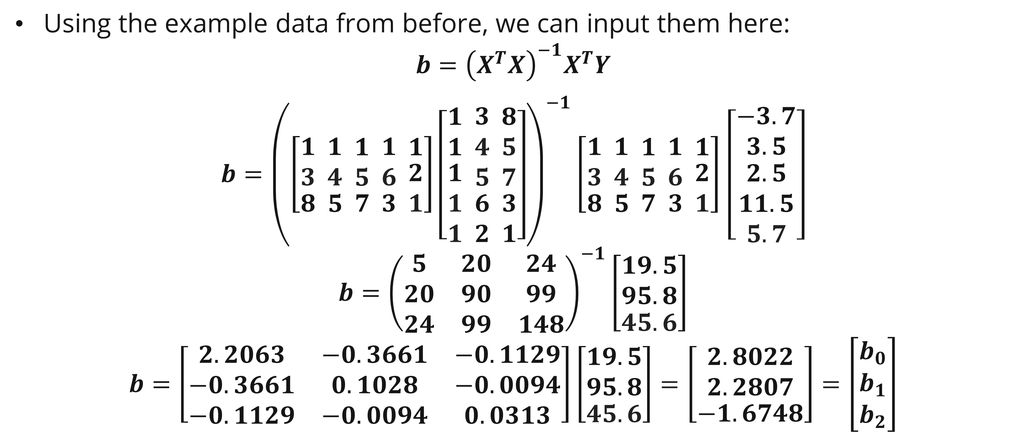
Multi variable regression
Example
Using the example data from before, we can input them here:
$$b={\left(X^{T}X\right)}^{−1}X^{T}Y$$
$b={\left(\left[\begin{matrix}\begin{aligned}1 \\ 3\end{aligned} \\ 8\end{matrix}\begin{matrix} \begin{aligned}1 \\ 4\end{aligned} \\ 5\end{matrix}\begin{matrix} \begin{aligned}1 \\ 5\end{aligned} \\ 7\end{matrix}\begin{matrix} \begin{aligned}1 \\ 6\end{aligned} \\ 3\end{matrix} \begin{matrix}1 \\ \begin{aligned}2 \\ 1\end{aligned}\end{matrix}\right]\left[\begin{matrix}1 \\ 1 \\ \begin{aligned}1 \\ 1 \\ 1\end{aligned}\end{matrix}\begin{matrix}\begin{aligned} 3 \\ 4 \\ 5\end{aligned} \\ 6 \\ 2\end{matrix}\begin{matrix} \begin{aligned}8 \\ 5 \\ 7\end{aligned} \\ 3 \\ 1\end{matrix}\right]\right)}^{−1}\left[\begin{matrix}\begin{aligned}1 \\ 3\end{aligned} \\ 8\end{matrix}\begin{matrix} \begin{aligned}1 \\ 4\end{aligned} \\ 5\end{matrix}\begin{matrix} \begin{aligned}1 \\ 5\end{aligned} \\ 7\end{matrix}\begin{matrix} \begin{aligned}1 \\ 6\end{aligned} \\ 3\end{matrix} \begin{matrix}1 \\ \begin{aligned}2 \\ 1\end{aligned}\end{matrix}\right]$ $\left[\begin{matrix}−3.7 \\ 3.5 \\ \begin{aligned}2.5 \\ 11.5 \\ 5.7\end{aligned}\end{matrix}\right]$
$$b={\left(\begin{matrix}5 & 20 & 24 \\ 20 & 90 & 99 \\ 24 & 99 & 148\end{matrix}\right)}^{−1}\left[\begin{matrix}\begin{aligned}19.5 \\ 95.8\end{aligned} \\ 45.6\end{matrix}\right]$$
$$b=\left[\begin{matrix}2.2063 & −0.3661 & −0.1129 \\ −0.3661 & 0.1028 & −0.0094 \\ −0.1129 & −0.0094 & 0.0313\end{matrix}\right]\left[\begin{matrix}\begin{aligned}19.5 \\ 95.8\end{aligned} \\ 45.6\end{matrix}\right]=\left[\begin{matrix}\begin{aligned}2.8022 \\ 2.2807\end{aligned} \\ −1.6748\end{matrix}\right]=\left[\begin{matrix}\begin{aligned}b_{0} \\ b_{1}\end{aligned} \\ b_{2}\end{matrix}\right]$$
Notes:
Need to augment the X matrix with 1 for the first column
Node that the results are identical to previous slide

Slide 16
Exercise
Accu-Copiers, Inc., sells and services the Accu-500 copying machine. As part of its standard service contract, the company agrees to perform routine service on this copier. To obtain information about the time it takes to perform routine service, Accu-Copiers has collected data for 10 service calls.
  Find the least squares point estimates b0 and b1
  Find the fitted linear regression equation

Slide 17
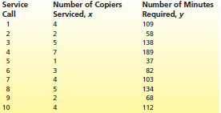
Exercise

Slide 18
References
Session 20
Peter Norvig, Stuart Russel. (2021). Artificial Intelligence: A Modern Approach. Pearson. London. ISBN: 978-1292401133. Ch. 19-20.
Anderson, D. R. (2020). Essentials of modern business statistics with Microsoft Excel (8e ed.). Cengage.
James, G., Witten, D., Hastie, T., Tibshirani, R., & Taylor, J. (2023). An introduction to statistical learning: With applications in Python. Springer.

